Slide 2
Day 2: Advanced survival course Multi-state modelling
Nicole De La Mata

Slide 3
Overview
Basic concepts of multi-state survival modelling
Study examples
Definitions
Estimators
Worked example
Non-parametric
Cox & flexible parametric
Considerations
Further concepts
Data exercise

Slide 4
Basic concepts of multi-state modelling

Slide 5
Multi-state modelling concept
Patients are still followed-up over time
But patient are observed to transition between states
Can be considered an extension to ‘competing risks’ scenario
0
Alive
1
Death
Two-state model
Notes:
Multi-state modelling considers that patients are followed up over continuous time period, but are observed to transition to different states over the follow-up period.
There are different states where a subject can occupy and possible transitions between these states, represented with arrows.
In the simplest form, the two state survival model, is how most survival analysis to all-cause death work. The individuals are in an alive state and then we observe their deaths, if they occur.
Multi-state models can be considered an extension of competing risks model

Slide 6
Multi-state modelling concept
1
Death, cause 1
0
Alive
….
k
Death, cause k
Competing risk model with k causes of death
Notes:
The competing risks approach extends this further, by dividing the causes by their causes and so have multiple final death states. Multi-state modelling approach can also be used in these settings.
Competing risks have an initial state and several mutually exclusive absorbing states. While multi-state….

Slide 7
Multi-state modelling concept
0
Alive
1
Diseased
2
Dead
Three-state model
Notes:
Will generally have intermediate states that neither are initial or final.
Three state model with diseased intermediate state and no return to non-diseased/alive state.

Slide 8
Multi-state modelling concept
0
At risk
1
Health event
2
Dead
Three-state model: recurrent events
Notes:
Three-state model for recurrent events, where individuals can returned to ‘at risk’ state for the event

Slide 9
Multi-state modelling concept
0
No event
1
One event
2
Two events
…
D
Dead
k-state model: recurrent events
Notes:
Alternatively, there can be no intervals between at-risk periods.

Slide 10
Study examples

Slide 11
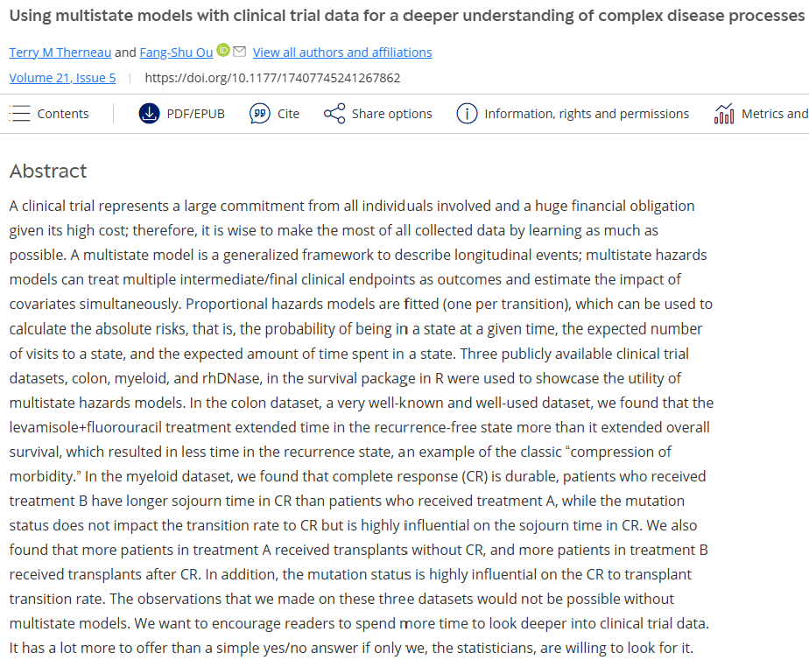
Study examples: Colon cancer
Notes:
Terry Therneau – well known statistician at Mayo clinic in survival analysis, particularly extending Cox models and multiple events, competing risks and correlated data.

Slide 12
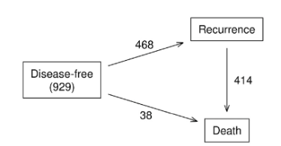
Study examples: Colon cancer
Three-state model for colon cancer.
Contains 929 patients with Duke stage C disease, randomly assigned to observation, levamisole alone (Lev) or levamisole in combination with fluorouracil (Lev+5FU).
Control arm was both observation and levamisole alone (Lev)
(1) Estimating probability in state and (2) intervention effect on transition intensities.
Notes:
Three examples shown in this paper. We will focus on the colon cancer example.
Control arm included both observation only and levamisole alone as there was no difference in disease free survival.
Note that there are very few transitions from disease free to death.
They were interested in estimating the probability in being in each state over time and using regression modelling to estimate transition intensities.

Slide 13
Study examples: Colon cancer
Sought to report:
(1) probability of being in state h at time t, given baseline covariate vector
(2) Expected number of visits to state h by time t, given baseline covariate vector
(3) Expected time spent in state h by time t.

Slide 14
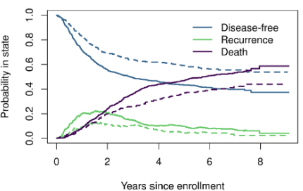
Study examples: Colon cancer
Aalen-Johansen estimates for probability in each state.
Solid line was control, dotted line was levamisole+fluorouracil.

Slide 15
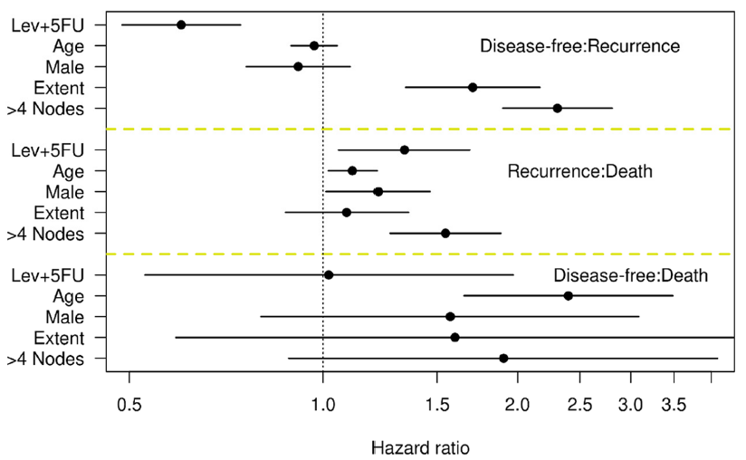
Study examples: Colon cancer
Fitted Cox proportional hazards model per each transition (Disease free → recurrence, recurrence → death, disease free → death).
“Compression of morbidity”, proposed by Fries (1980)
Notes:
They do discuss the effect of increased risk of recurrence to death in the intervention group.
“Compression of morbidity” by Fries (1980) – hypothesizes that if age of onset of the first chronic infirmity can be postponed, then the burden of lifetime illness may be compressed into a short period before the time of death. The treatment extended time before recurrence, by around 1.2 to 1.3 years, more than its extension of time before death. Therefore, the time spent in recurrence is compressed into a shorter period of time.

Slide 16
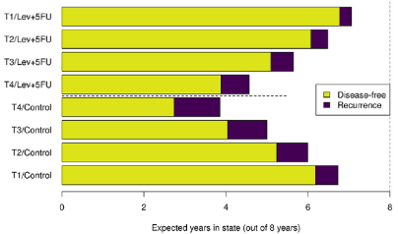
Study examples: Colon cancer
Expected time spent in each state. Blanks is deaths.
Extent of disease: T1 submucosa, T2 muscle, T3 serosa, T4 contiguous structures.

Slide 17
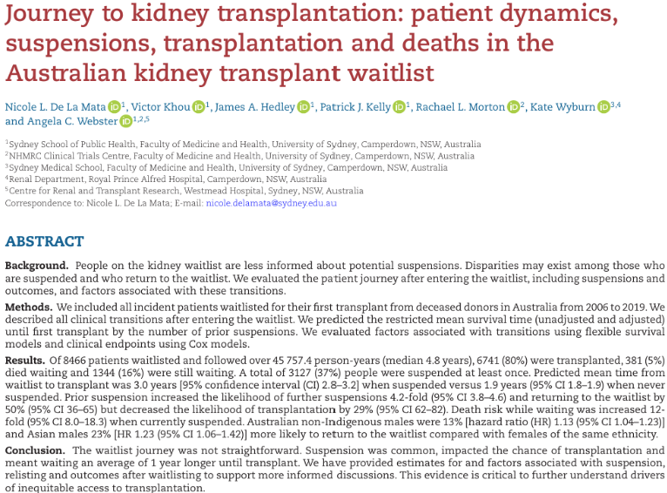
Study examples: Kidney waitlist

Slide 18
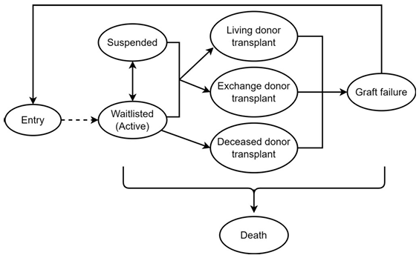
Study examples: Kidney waitlist
Complex dynamic process.
Total 8,466 waitlisted patients in Australia.
Patient and clinical factors on transition intensities: waitlist → suspension, suspension → waitlist

Slide 19
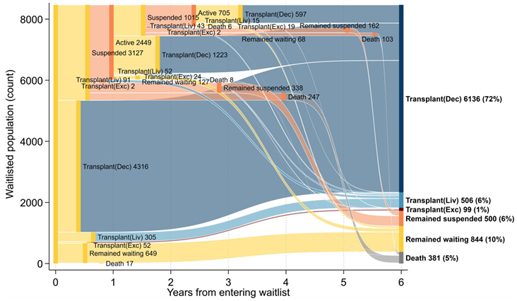
Study examples: Kidney waitlist

Slide 20
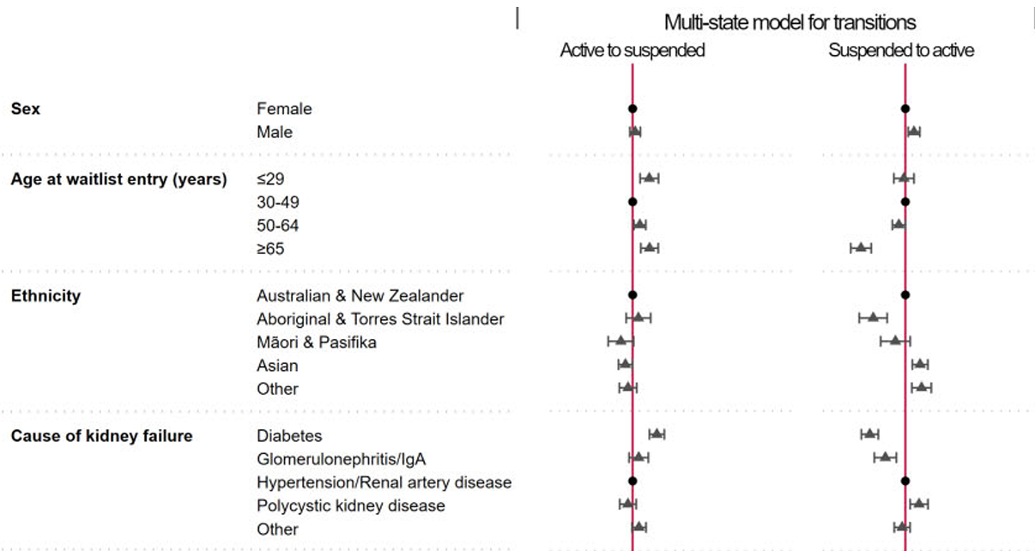
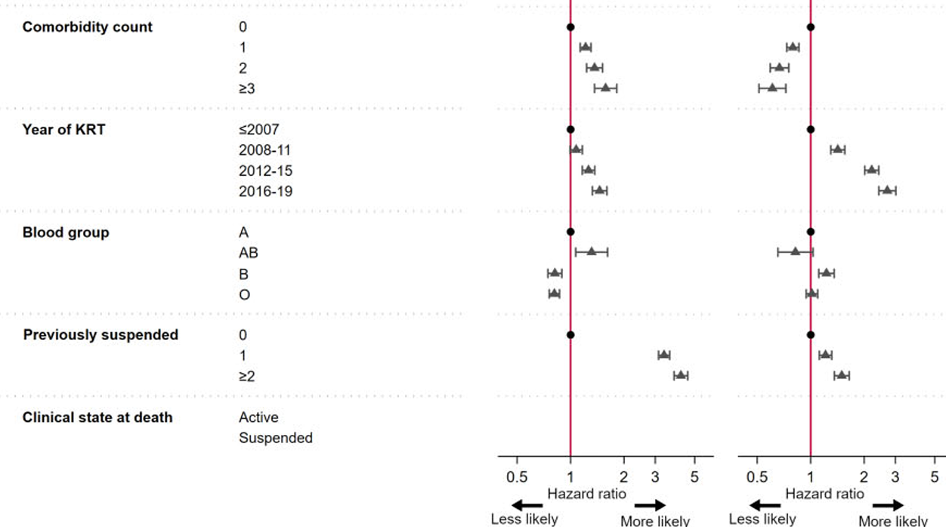
Study examples: Kidney waitlist
Flexible parametric multistate model

Slide 21
Study examples: Kidney waitlist

Slide 22
Definitions

Slide 23
Defining states
Absorbing states: Subjects will never leave state h once entered (e.g. death)
D
Dead

Slide 24
Defining states
Transient states: Subjects can move from state h to state j once entered (e.g. diseased)
0
At risk
1
Health event

Slide 25
Transition times
We consider where we can assume we have exact observed transition times, not where events have happened during some interval.
0
At risk
1
Health event
2
Dead
t₀
t₁
t₂
Time (t)

Slide 26
Transition times
We consider where we can assume we have exact observed transition times, not where events have happened during some interval.
0
At risk
1
Health event
2
Dead
t₀
t-t₁
t+t₁
t₂
Time (t)

Slide 27
Estimators

Slide 28
How can we model multi-state data?
Non-parametric approaches:
Nelson-Aalen estimator for cumulative hazard
Aalen-Johansen estimator for state occupation probability
Cox proportional ‘cause-specific’ hazards model
Flexible parametric ‘cause-specific’ hazards model
Markov multi-state
Notes:
We have now gathered some understanding of how to conceptualise multi-state data.
So, how do we go about modelling these data?
There are many different approaches and we have eluded to how we can consider multi-state as another form of competing risks.
But the intention now is to model to the transitions
Non parametric approach
Semi and parametric approach
Note about Markov models. We aren’t going to cover in this course but I will dabble in how that is a different process.
In general, Markov models are more useful in multi state modelling when exact transition times aren’t known and further the Markov assumption assumes “future state depends solely on the current state, not on sequence of events that preceded it” (i.e. it is memoryless).

Slide 29

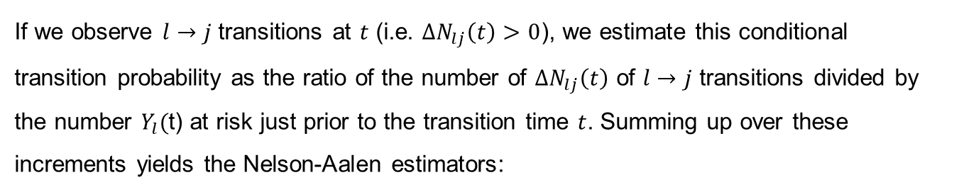
Nelson-Aalen estimator
Cumulative transition hazard: Total cumulative risk of state h at time t.
Non-parametric.
If we observe $l→j$ transitions at $t$ (i.e. ${∆N}_{lj}\left(t\right)>0$), we estimate this conditional transition probability as the ratio of the number of ${∆N}_{lj}\left(t\right)$ of $l→j$ transitions divided by the number $Y_{l}($t) at risk just prior to the transition time $t$. Summing up over these increments yields the Nelson-Aalen estimators:
$${\hat{A}}_{lj}\left(t\right)=\sum_{s≤t}{\frac{∆N_{lj}(s)}{Y_{l}(s)}}, l≠j$$

Slide 30
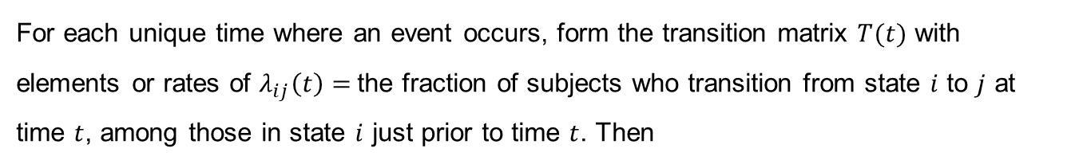

Aalen-Johansen estimator
State occupation probability: The probability (risk) of being in state h at time t.
Non-parametric.
Matrix version of the Kaplan-Meier estimator.
For each unique time where an event occurs, form the transition matrix $T(t)$ with elements or rates of $λ_{ij}\left(t\right)=$the fraction of subjects who transition from state $i$ to $j$ at time $t$, among those in state $i$ just prior to time $t$. Then
$$p\left(t\right)=p(0)\prod_{s≤t}{T(s)}$$
Area under curve provides mean time-in-state.
Where $p(0)$ is the initial distribution of subjects.
Notes:
T is equal to the identity matrix at any time point without an observed transition
Cumulative incidence is a special case of the Aalen-Johansen estimates

Slide 31
How can we model multi-state data?
Non-parametric approaches:
Nelson-Aalen estimator for cumulative hazard
Aalen-Johansen estimator for state occupation probability
Cox proportional ‘cause-specific’ hazards model
Flexible parametric ‘cause-specific’ hazards model
Notes:
Referred to these as cause-specific because they are essentially are these, but are instead transition based.

Slide 32
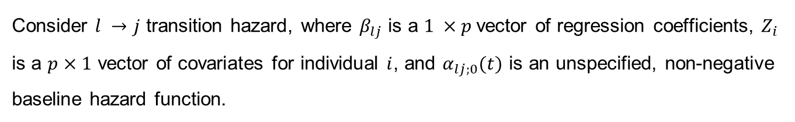
Transition intensities
Describe the instantaneous risks of transitions between the states (akin to hazard)
Consider $l →j$ transition hazard, where $β_{lj}$ is a $1 ×p$vector of regression coefficients, $Z_{i}$ is a $p×1$ vector of covariates for individual $i$, and $α_{lj;0}(t)$ is an unspecified, non-negative baseline hazard function.
$$α_{lj;i}\left(t; Z_{i}\right)= α_{lj;0}\left(t\right)∙\exp\left(β_{lj}∙Z_{i}\right), l,j∈\left\{0,1,2…,J\right\}, l≠j, i=1,…n$$
Notes:
Given that an individual is in state X(t) at time t, their next state, and the time of the change, are governed by a set of transition intensities or transition hazards.
The intensity represents the instantaneous risk of moving from state l to state j, and is zero if the transition is impossible.
It may dependent on covariates Z(t) and the time t itself

Slide 33
Transition intensities
Describe the instantaneous risks of transitions between the states (akin to hazard)
Depends on time t since time origin and on baseline (i.e. time fixed covariates)
Hazard does not necessary depend on time at which entering current state (i.e. does not consider time spent in prior state)
Assumes common baseline hazard, regardless of how many times they entered this state before
$$α_{lj;i}\left(t; Z_{i}\right)= α_{lj;0}\left(t\right)∙\exp\left(β_{lj}∙Z_{i}\right), l,j∈\left\{0,1,2…,J\right\}, l≠j, i=1,…n$$
Notes:
We could incorporate time spent in prior state using time-dependent covariates, but these can pose other interpretative challenges (please refer to Chapter 11 of Competing Risks and Multistate Models with R).
For example, baseline hazard for ‘getting ill’ is same both for individuals who have been ‘ill’ before and for individuals who have acquired ‘illness’ and ‘recovered’. Again this can be addressed by time-dependent covariates or amend multistate model such as we define first illness, second illness etc.

Slide 34
Marginal parameters
Marginal parameters express: You place yourself at time 0 and ask questions about aspects of the multi-state process V(ꞏ) at a later time point t (without consideration of what may happen between 0 and t).
State occupation probability: The probability (risk) of being in state h at time t.
Restricted mean: The expected time spent in state h being time t.
Distribution of time T_{h} to (first) entry into state h (relevant if everyone starts at time 0 in the same state 0).
Expected number of events before time t: relevant for recurrent events process N(ꞏ), counting the number of events over time

Slide 35
Conditional parameters
Conditional parameters for multi-state process V(ꞏ) quantify, at time t, the future development of the process conditionally on the past of the process before t.
Transition intensities: α_{lj}(t) gives the probability per time unit of moving to state j right after time t given that you are in state l at t and given the past up to t.
Transition probabilities: P_{lj}(s,t) gives the probability of being in state j at time t, given that you were in state l at an earlier time point s and given the past history of V(ꞏ) up to that earlier time point (also defined if l and j are the same state).

Slide 36

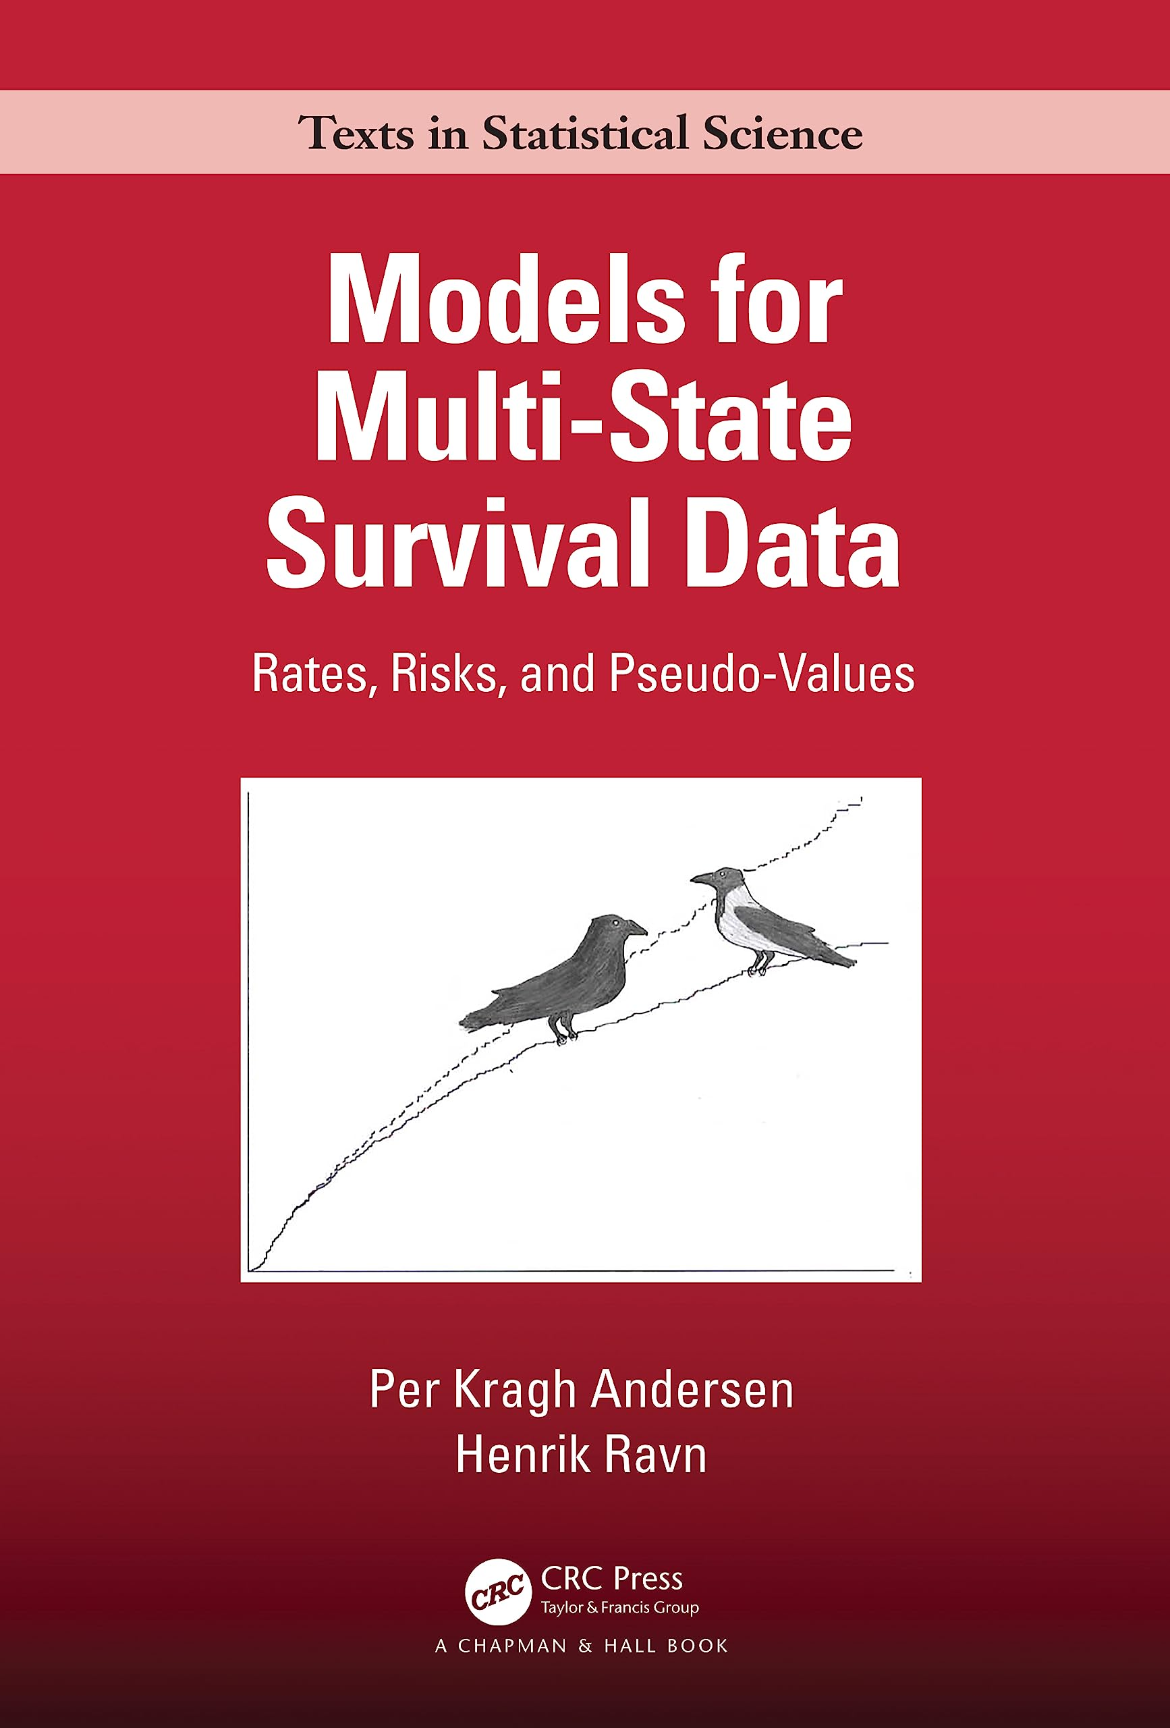

Slide 37
Data set-up & modelling

Slide 38
Data set up – What do we want?
ID | Start_time | End_time | Status
1 | 0.0 | 2.7 | recur
1 | 2.7 | 4.2 | death
2 | 0.0 | 8.5 | censor
3 | 0.0 | 1.5 | recur
3 | 1.5 | 2.6 | death
4 | 0.0 | 0.7 | recur
4 | 0.7 | 0.8 | death
5 | 0.0 | 1.4 | recur
5 | 1.4 | 1.8 | death
6 | 0.0 | 2.5 | recur
6 | 2.5 | 4.8 | death

Slide 39
Alternatively…
ID | Start_time | End_time | Status | Transition | State0 | State1
1 | 0 | 968 | 1 | 1 | entry | recur
1 | 0 | 968 | 0 | 2 | entry | death
1 | 968 | 1521 | 1 | 3 | recur | death
2 | 0 | 3087 | 0 | 1 | entry | recur
2 | 0 | 3087 | 0 | 2 | entry | death
3 | 0 | 542 | 1 | 1 | entry | recur
3 | 0 | 542 | 0 | 2 | entry | death
3 | 542 | 963 | 1 | 3 | recur | death
4 | 0 | 245 | 1 | 1 | entry | recur
4 | 0 | 245 | 0 | 2 | entry | death
4 | 245 | 293 | 1 | 3 | recur | death
Notes:
Provides each transition for each individual

Slide 40

Working from…. To this…
ID | Time | Status
1 | 2.7 | recur
1 | 4.2 | death
2 | 8.5 | censor
3 | 1.5 | recur
3 | 2.6 | death
4 | 0.7 | recur
4 | 0.8 | death
ID | Start_time | End_time | Status
1 | 0.0 | 2.7 | recur
1 | 2.7 | 4.2 | death
2 | 0.0 | 8.5 | censor
3 | 0.0 | 1.5 | recur
3 | 1.5 | 2.6 | death
4 | 0.0 | 0.7 | recur
4 | 0.7 | 0.8 | death

Slide 41
Worked example
Load colon cancer dataset from survival package.
R coding supplied and redacted from below:
Therneau, T. M., & Ou, F.-S. (2024). Using multistate models with clinical trial data for a deeper understanding of complex disease processes. Clinical Trials, 21(5), 531–540. https://doi.org/10.1177/17407745241267862

Slide 42
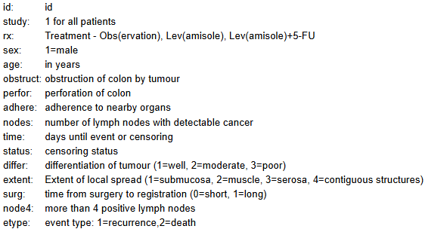
Worked example
Load colon cancer dataset from survival package.

Slide 43
Worked example
Load colon cancer dataset from survival package.
1. Create state space figure
#State space figure
states <- c("Disease-free\n(929", "Recurrence", "Death")
smat <- matrix(0, 3, 3, dimnames=list(from=states, to=states))
smat[1, 2:3] <- 1; smat[2, 3] <- 1
Smat
#smat is a matrix with a 1 for any valid transition, 0 otherwise
statefig(1:2, smat)

Slide 44
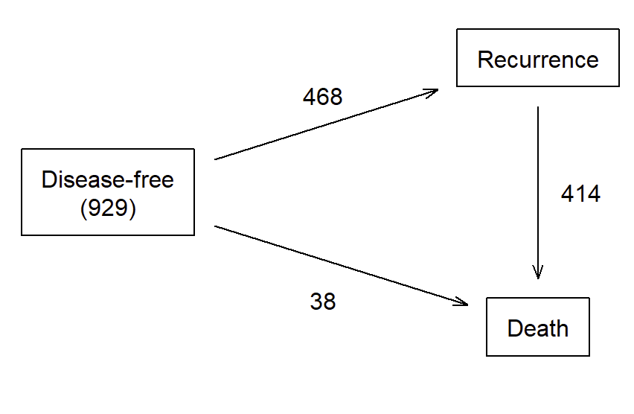
Worked example
1. Create state space figure

Slide 45
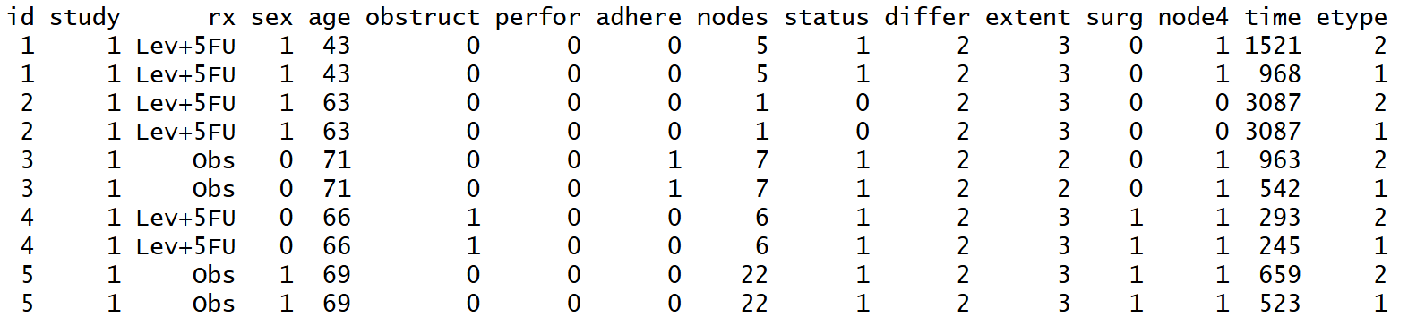
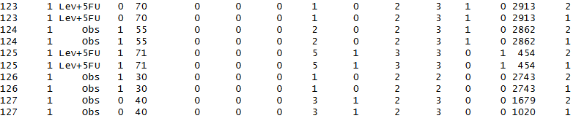
Worked example
2. Data checks for tied times
Notes:
Let’s have a look at the data.
Recall etype is 1 = recurrence and 2 = death. We have the time recorded for both, and in conjunction with status = 1 if event occurred or 0 if it didn’t.
We see no events occurred for id=2, and censored at the maximum time.
A lot of this data manipulation will depend on how your data is set up, but some of these coding can be reused for many instances.

Slide 46
Worked example
2. Data checks for tied times
#Divide the data into the two states
c1 <- subset(colon, etype== 1) # recurrence
c2 <- subset(colon, etype== 2) # death
#Check for tied times
tied.id <- (c1$time == c2$time & c1$status==1 & c2$status==1)
table(tied.id)
# There are 5 subjects with recurrence coded on the same day as death.
# Make them recur one day earlier than their death (avoid 0 length intervals)
c1$time[tied.id] <- c1$time[tied.id] -1
Notes:
To address the tie, we will make recur occur one day prior to death where the events have occurred.

Slide 47
Worked example
3. Recombine data to have time1 to time2, and state variable
# Create the counting process dataset
cdata <- tmerge(subset(c2, ,-c(study, time, status, etype)),c2, id=id, death= event(time, status),options=list(tstart="time1", tstop="time2"))
cdata <- tmerge(cdata, c1, id= id, recur= event(time, status),td.recur = tdc(time))
#Check transitions
table(cdata$recur, cdata$death)
# The table above verifies no tied event times
# Make the state variable
cdata$state <- with(cdata, factor(recur+ 2*death, 0:2,c("censor", "recur", "death")))
Notes:
Somewhat a simple example, as recur is only event that would precede death.
Other scenarios are more complex, particularly when they re-loop between states.

Slide 48
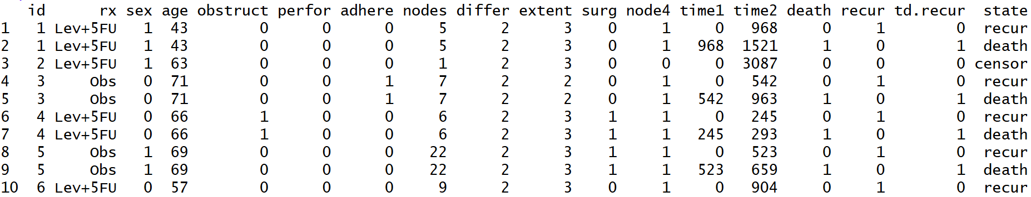
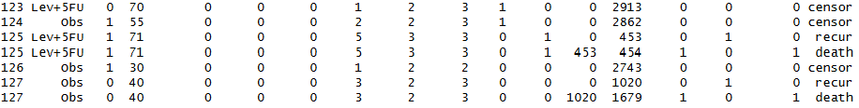
Worked example
3. Recombine data to have time1 to time2, and state variable

Slide 49
Worked example
4. We are mostly prepared for the Nelson-Aalen and Aalen-Johansen estimates, after some minor adjustments to variables and time from days to years.
The survcheck() command can also produce a summary of transitions.
# Check for consistencycheck <-survcheck(Surv(time1, time2, state) ~ 1, cdata, id=id)check
Notes:
Haven’t included coding here for covariates, but it is on the quarto document.

Slide 50
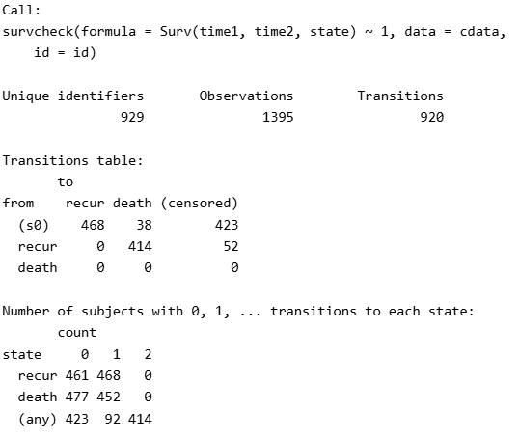
Worked example
Notes:
Haven’t included coding here for covariates, but it is on the quarto document.

Slide 51

Notes:
Haven’t included coding here for covariates, but it is on the quarto document.

Slide 52
Non-parametric estimates

Slide 53
Nelson-Aalen estimates
Character for censored observations
#Nelson-Aalen estimates
mvna(data, state.names, tra, cen.name)
(id, from state, to state, time) OR
(id, from state, to state, entry time, exit time)
Matrix of possible transitions
Vector character of state names

Slide 54
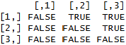
Nelson-Aalen estimates – transition matrix
To
From
#Nelson-Aalen estimates
na <- mvna(cdata_na, c("entry", "recur", "death"), tra, "cens")
Notes:
1 = entry, 2 = recur, 3 = death

Slide 55
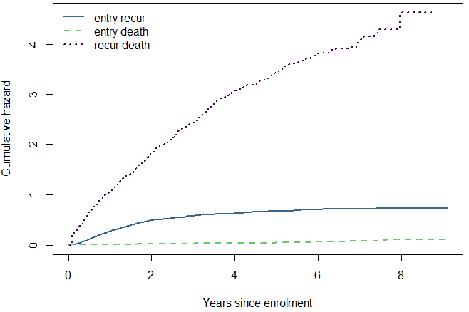
Nelson-Aalen estimates – plot
Notes:
1 = entry, 2 = recur, 3 = death

Slide 56
Aalen-Johansen estimates
#Aalen-Johansen estimates
aj0 <- survfit(Surv(time1, time2, state) ~1, data=cdata, id=id) # overall
aj1 <- survfit(Surv(time1, time2, state) ~ trt, data=cdata, id=id) # by arm
**Note: Functions similar to KM estimates, so it creates stratum for estimates. Easy to make too many stratums and too few events.

Slide 57
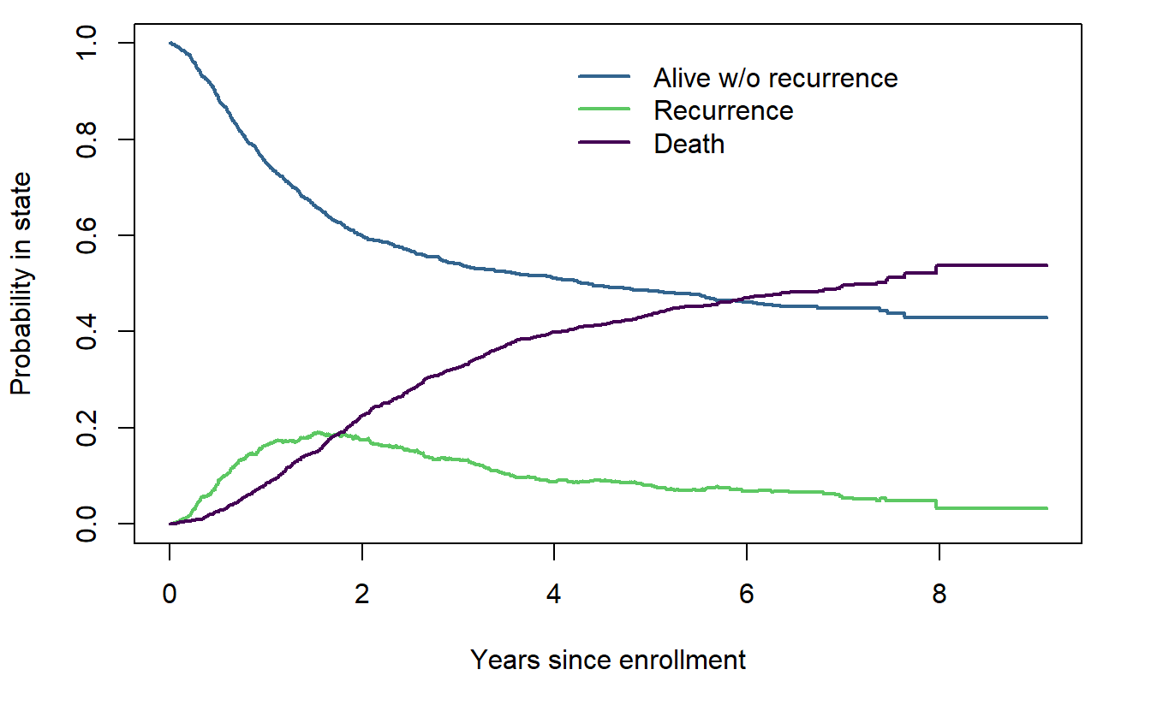
Aalen-Johansen estimates - overall

Slide 58
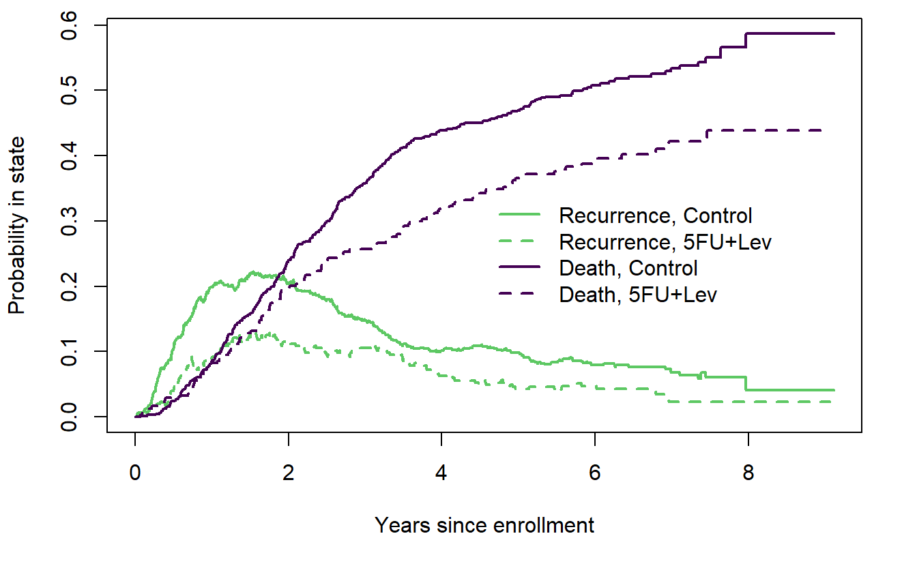
Aalen-Johansen estimates – by treatment

Slide 59
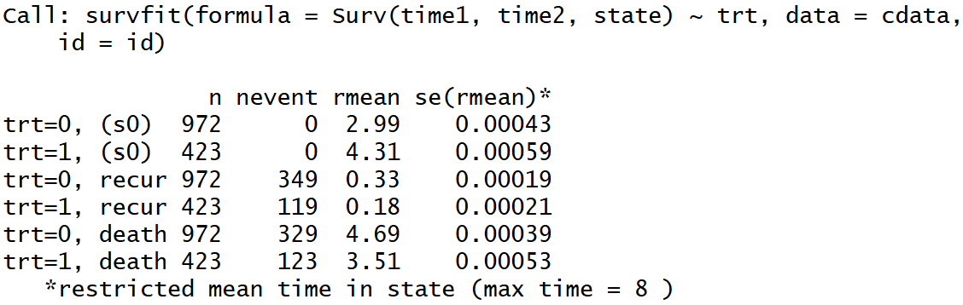
Aalen-Johansen estimates - expected time in state
#Expected time in state
print(aj1, rmean= 8, digits=2) #print sojourn time restricted to 8 years
Notes:
Rmean adds to 8 for each stratum

Slide 60
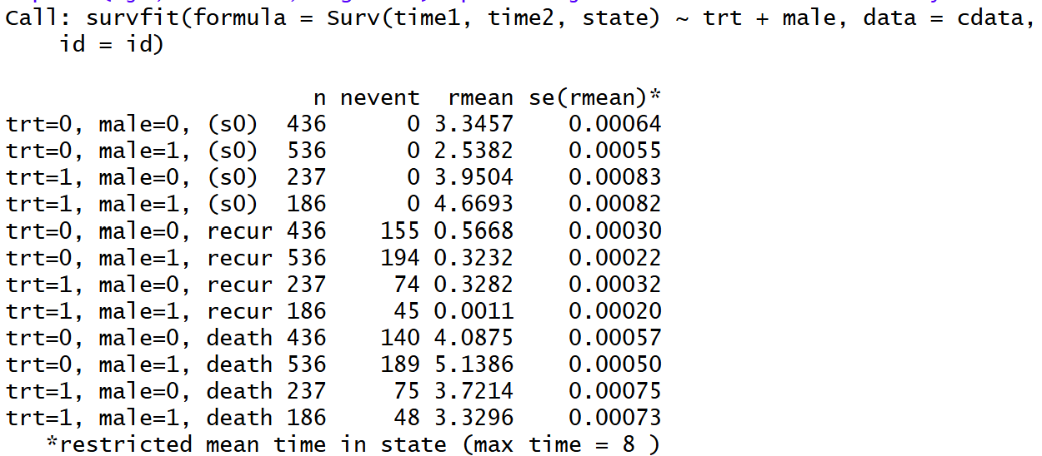
Aalen-Johansen estimates - expected time in state
#Adjusted AJ for expected times
aj2 <- survfit(Surv(time1, time2, state) ~ trt+male, data=cdata, id=id) # by arm
#Print expected times
print(aj2, rmean= 8, digits=2) #print sojourn time restricted to 8 years
**Note: Functions similar to KM estimates, so it creates stratum for estimates. Easy to make too many stratums and too few events.

Slide 61
Cox proportional ‘transition-specific’

Slide 62
Cox proportional hazards
# fit the model
cfit <- coxph(Surv(time1, time2, state) ~ trt +age10 + male + extent + node4,data=cdata, id=id)
print(cfit, digits=2)
summary(cfit)

Slide 63
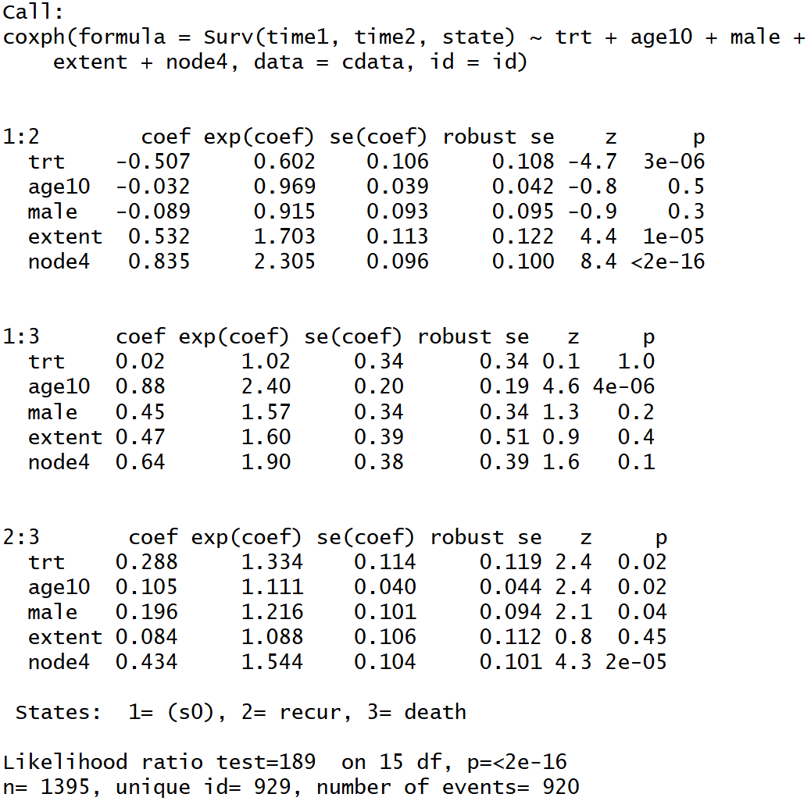
Cox proportional hazards
print()
Notes:
Print function – doesn’t show 95%CI but point estimates of transition HR

Slide 64
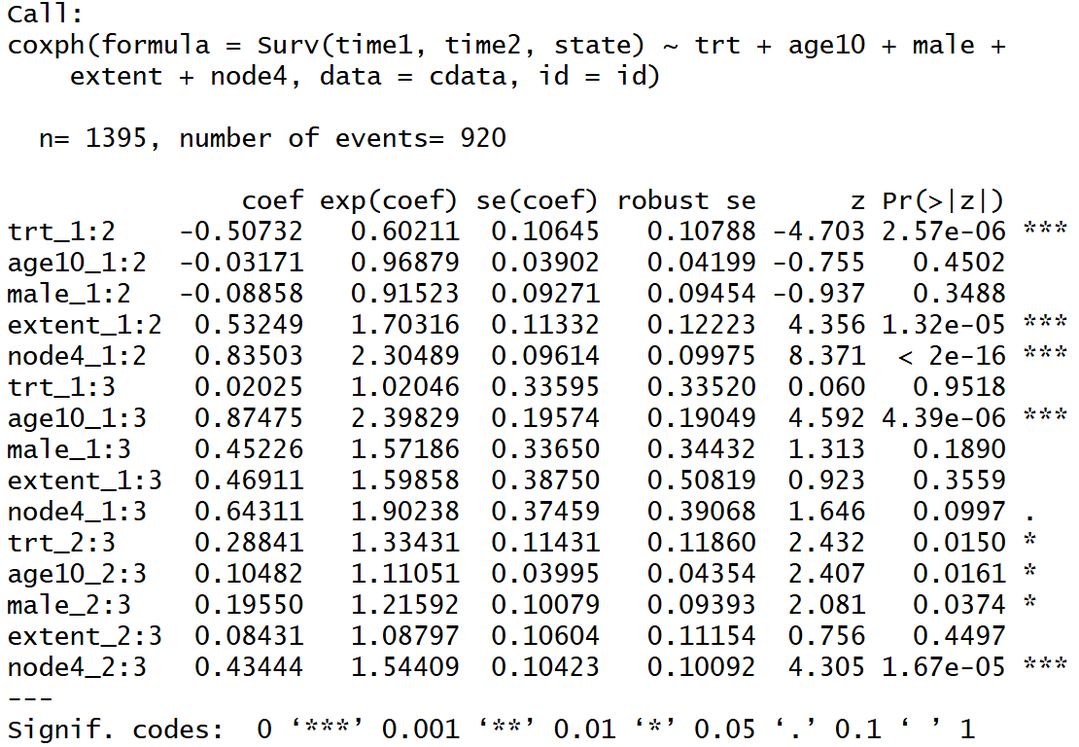
Cox proportional hazards
summary()
Notes:
summary function – includes 95%CI

Slide 65
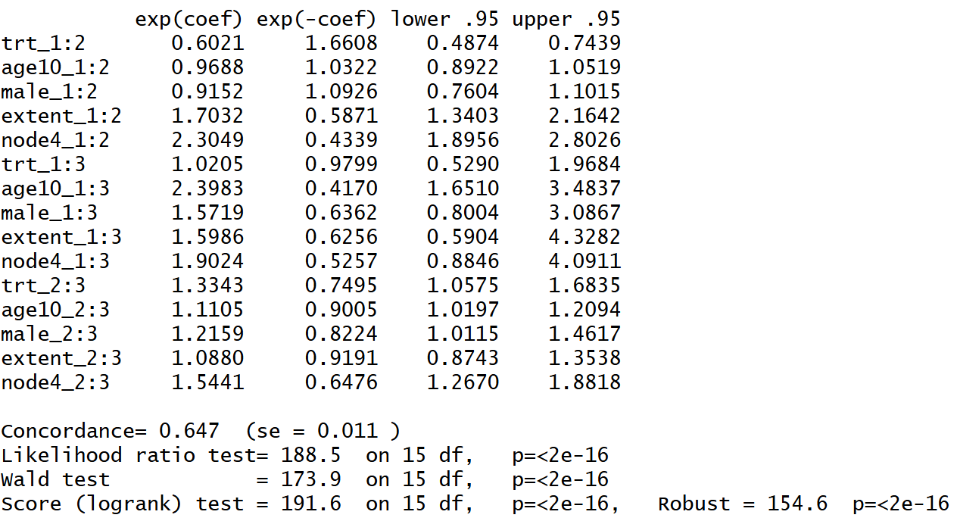
Cox proportional hazards
summary()
Notes:
summary function – includes 95%CI

Slide 66
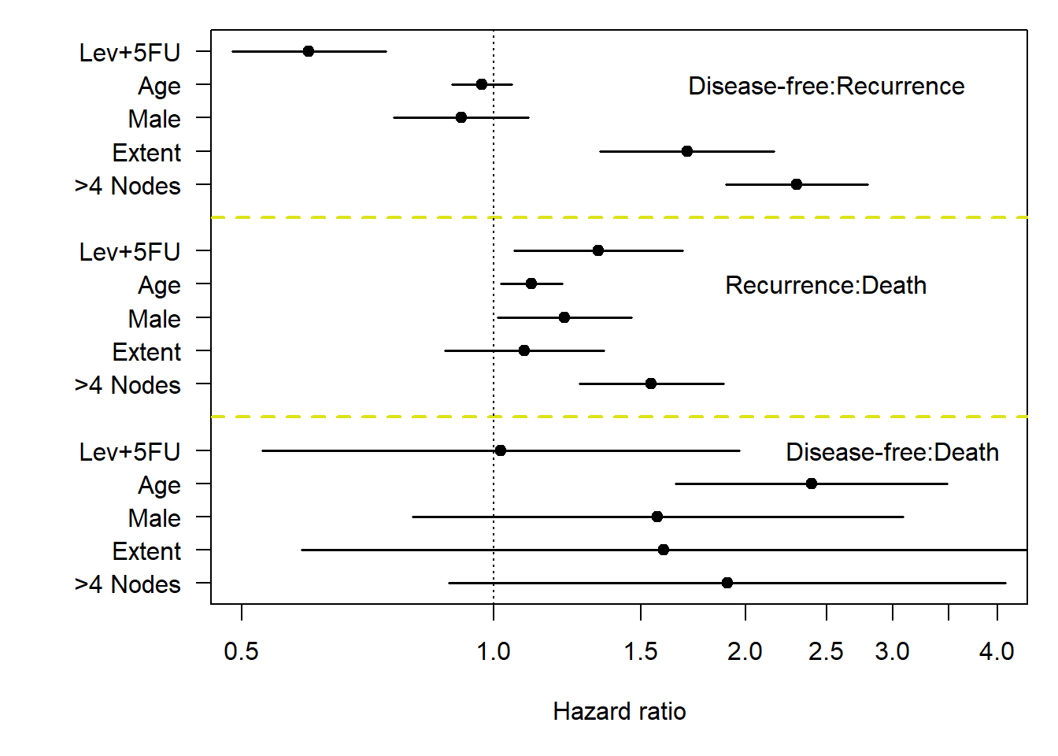
Cox proportional hazards
Refer to R coding for figure
Notes:
summary function

Slide 67
Cox proportional hazards – expected mean in each state
#Simplified model
cfit2 <- coxph(Surv(time1, time2, state) ~ trt + extent + node4, data=cdata, id=id)
#Create dummy data
dummy <- expand.grid(trt=0:1, extent=1:4, node4= 0:1) # 16 combinations
# Predicted probability in state from the MSH model
csurv2 <- survfit(cfit2, newdata=dummy) # 16 predicted curves
# calculate the sojourn time and assemble it into a matrix
temp <- summary(csurv2, rmean=8)$table[,"rmean"]
Notes:
summary function

Slide 68
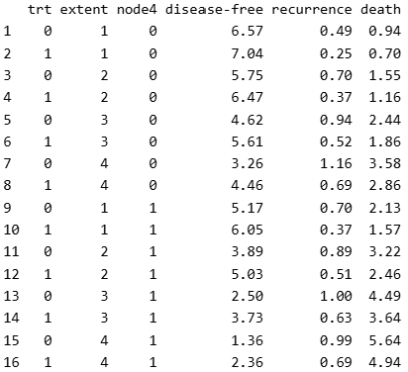
Cox proportional hazards – expected mean in each state
Notes:
summary function

Slide 69
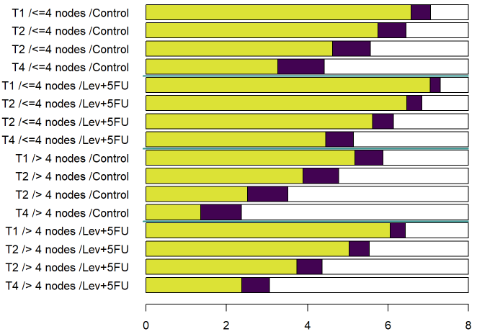
Cox proportional hazards – expected mean in each state
Notes:
summary function

Slide 70
‘mstate’ package

Slide 71
Using mstate package
Functions for data prep, descriptives, estimation and prediction in competing risks and multi-state models.
Notes:
summary function

Slide 72
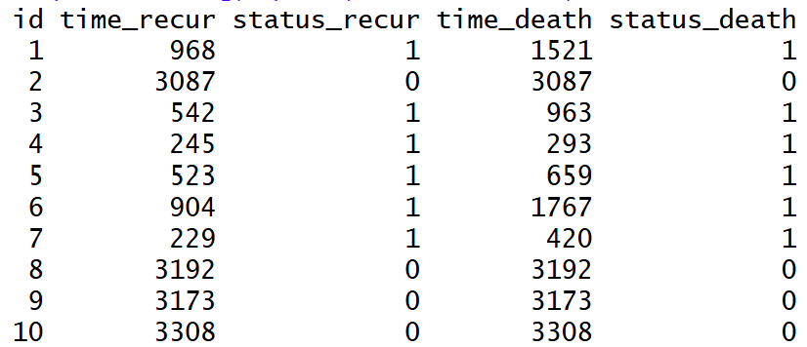
Using mstate package
Wide formatted multi-state data
+ covariates

Slide 73
msprep function
#Transition matrix
tmat <- transMat(x = list(c(2,3), c(3), c()), names=c("Alive", "Recurrence", "Death"))
#Reshape using msprep
cdata_long <- msprep(data=cdata_wide, trans=tmat, time=c(NA, "time_recur", "time_death"), status=c(NA, "status_recur", "status_death"), keep=c("rx", "sex", "age", "obstruct", "perfor", "adhere", "nodes", "differ", "extent", "surg", "node4"))
**Must check for tied times prior to msprep

Slide 74
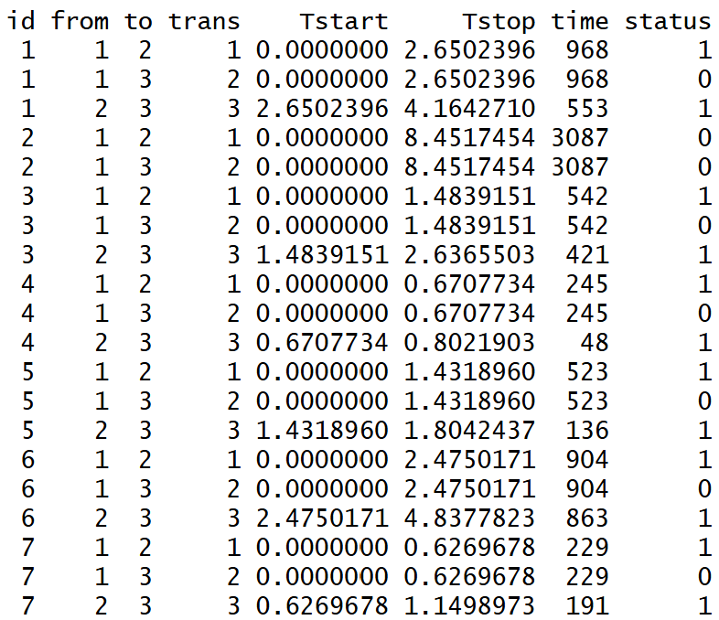
msprep function
Individuals must have first entered that state to have status outcome for trans

Slide 75
msprep function
Individuals must have first entered that state to have status outcome for trans

Slide 76
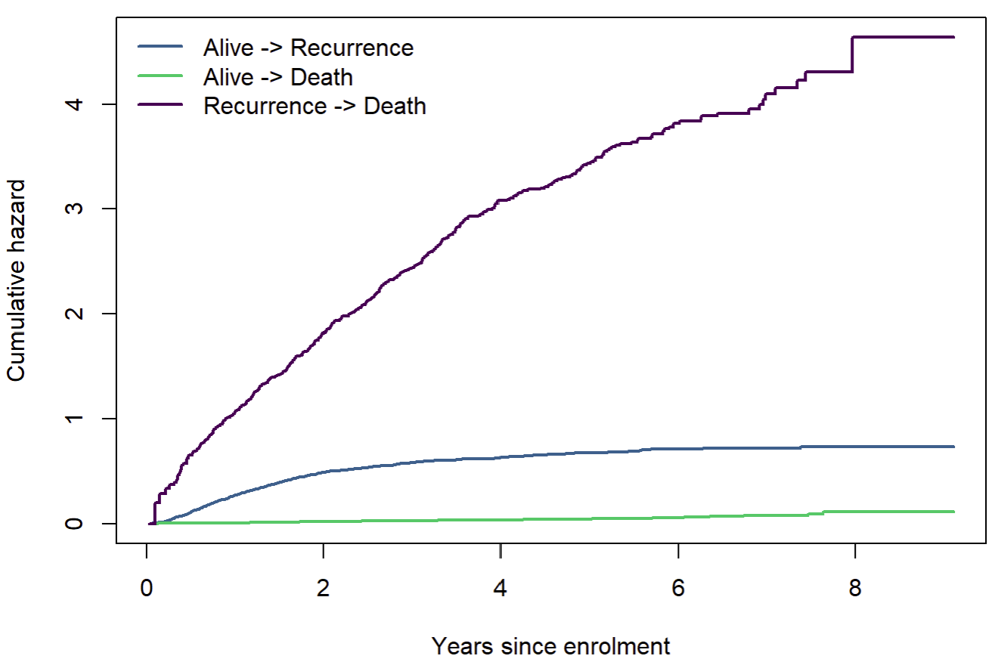
Non-parametric estimates
#Cumulative hazards
msfit_mstate <- msfit(cfit_mstate, trans=tmat)
Notes:
Otherwise, by fitting trans as a strata, you will get covariate effects that are ‘shared’ or common among all the transitions.

Slide 77
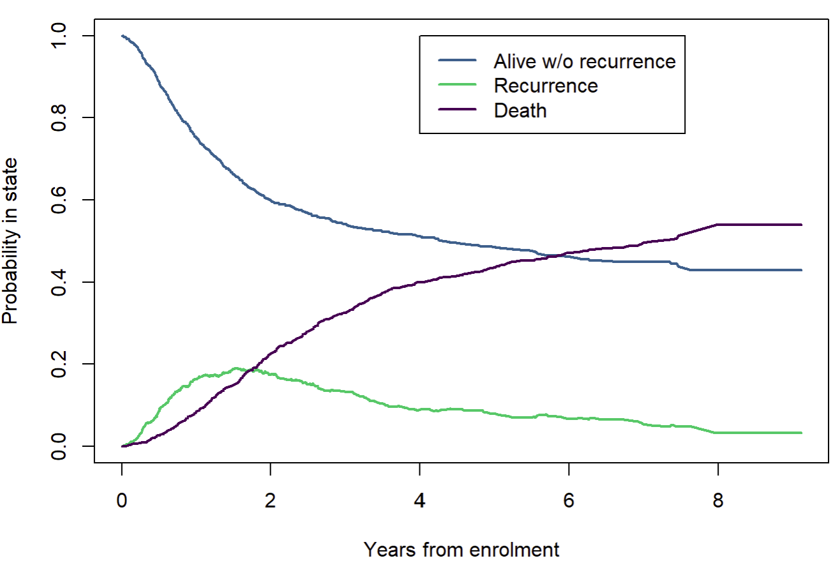
Non-parametric estimates
#Probabilities in state
pr0 <- probtrans(msfit_mstate, predt = 0)
#From entry to other states
pr0_from1 <- pr0[[1]]
Notes:
Otherwise, by fitting trans as a strata, you will get covariate effects that are ‘shared’ or common among all the transitions.

Slide 78
Non-parametric estimates
However, trans is fitted in strata and transition-specific covariates are set-up in a different way.
Notes:
Otherwise, by fitting trans as a strata, you will get covariate effects that are ‘shared’ or common among all the transitions.

Slide 79
Fitting transitions in mstate
#Fit Cox model with separate baseline hazards for each transition
cfit_mstate <- coxph(Surv(Tstart, Tstop, status) ~ strata(trans),data=cdata_long, id=id)
#Cumulative hazards
msfit_mstate <- msfit(cfit_mstate, trans=tmat)
#Probabilities in state
pr0 <- probtrans(msfit_mstate, predt = 0)

Slide 80
Transition-specific covariates
#Expand covariates to fit transition-specific covariates
covs <- c("trt", "age10", "male", "extent", "node4")
cdata_long_exp <- expand.covs(cdata_long, covs, longnames=FALSE)
Specified 5 covariates for 3 transitions
cdata_long (22 variables) → cdata_long_exp (37 variables)
Notes:
Additional 15 variables for 5 covariates by 3 transitions

Slide 81
Transition-specific covariates
#Fit cox model with transition specific covariat
cfit_tspec_strata <- coxph(Surv(Tstart, Tstop, status) ~ trt.1 + trt.2 + trt.3 + age10.1 + age10.2 + age10.3 + male.1 + male.2 + male.3 + extent.1 + extent.2 + extent.3 + node4.1 + node4.2 + node4.3 + strata(trans),data=cdata_long_exp, id=id)
summary(cfit_tspec_strata)
Nearly exactly the same coefficient estimates as:
# fit the model
cfit <- coxph(Surv(time1, time2, state) ~ trt +age10 + male + extent + node4,data=cdata, id=id)
print(cfit, digits=2)
summary(cfit)

Slide 82
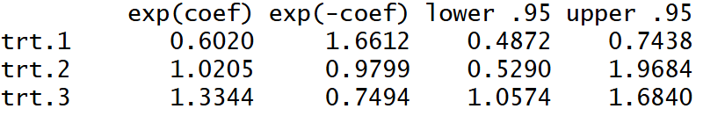
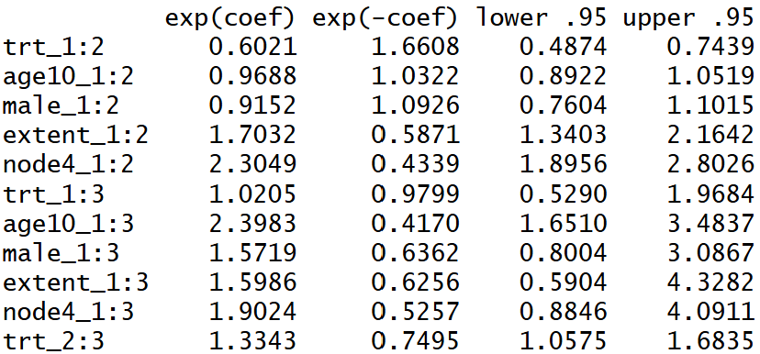
Transition-specific covariates
Coxph with strata(trans) and trans specific covariates
Coxph with state in Surv()

Slide 83
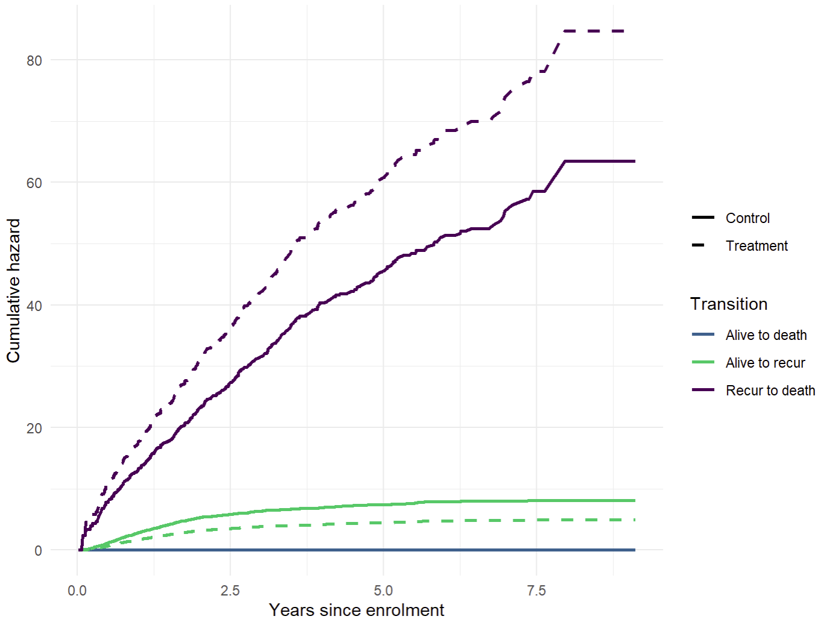
Transition-specific covariates
Able to produce covariate effects in cumulative hazard

Slide 84
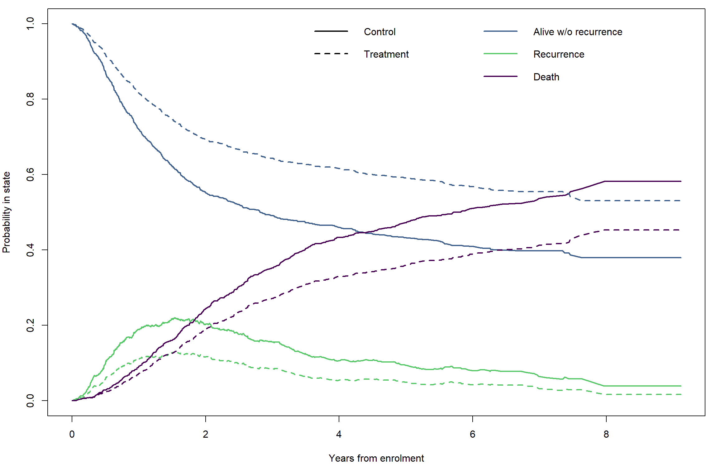
Transition-specific covariates
And probability in state

Slide 85
‘flexsurv’ package

Slide 86
Flexible parametric survival models – transition specific
Recall we have three transition types:
Disease-free to recurrence
Disease-free to death
Recurrence to death
Notes:
The flexsurv package works quite well integrating with some of the functions in mstate.
We can use output from msprep to model transition-specific models using flexsurvreg and flexsurvspline.

Slide 87
Flexible parametric survival models – transition specific
#Fit separate models for each transition - as given by msprep
msm_alive_recur <- flexsurvspline(Surv(Tstop, status) ~ trt +age10 + male + extent + node4, data=cdata_long, subset=(trans==1), k=0, scale="hazard")
msm_alive_recur
msm_alive_death <- flexsurvspline(Surv(Tstop, status) ~ trt +age10 + male + extent + node4, data=cdata_long, subset=(trans==2), k=0, scale="hazard")
msm_alive_death
msm_recur_death <- flexsurvspline(Surv(Tstop, status) ~ trt +age10 + male + extent + node4, data=cdata_long, subset=(trans==3), k=0, scale="hazard")
msm_recur_death

Slide 88
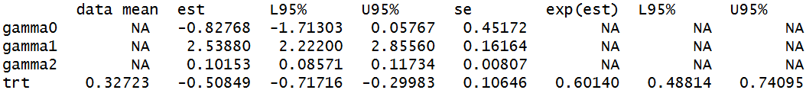
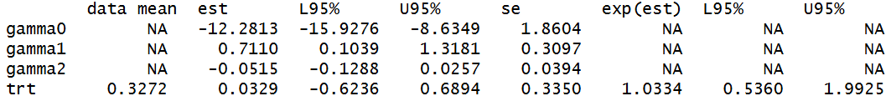
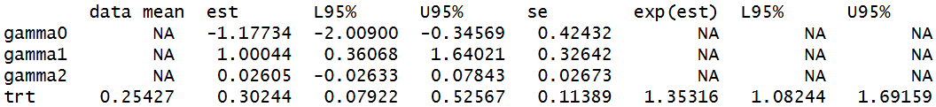
Flexible parametric survival models – transition specific
msm_alive_recur
msm_alive_death
msm_recur_death
Notes:
There are other covariates in the model but we have focused on the treatment effect.
These are very similar to what we have seen in the coxph models.
Treatment reduced hazard of transitioning from alive to recurrence. No difference for alive to death.
Treatment increased hazard of transitioning from recurrence to death.

Slide 89
Flexible parametric survival models – transition specific
#Define transition matrix
tmat_flexsurv <- rbind(c(NA,1,2), c(NA, NA, 3), c(NA, NA, NA))
tmat_flexsurv
#Group transitions together
msm_alltrans <- fmsm(msm_alive_recur, msm_alive_death, msm_recur_death, trans=tmat_flexsurv)
msm_alltrans
Notes:
We can join these separate transition specific models into one object using

Slide 90
Cumulative hazard
#Cumulative intensity function – control
cum_trans0<- msfit.flexsurvreg(msm_alltrans, t=seq(0,5,by=0.2), newdata=msm_preddata0, trans=tmat_flexsurv)
#Cumulative intensity function – treatment
cum_trans1<- msfit.flexsurvreg(msm_alltrans, t=seq(0,5,by=0.2), newdata=msm_preddata1, trans=tmat_flexsurv)

Slide 91
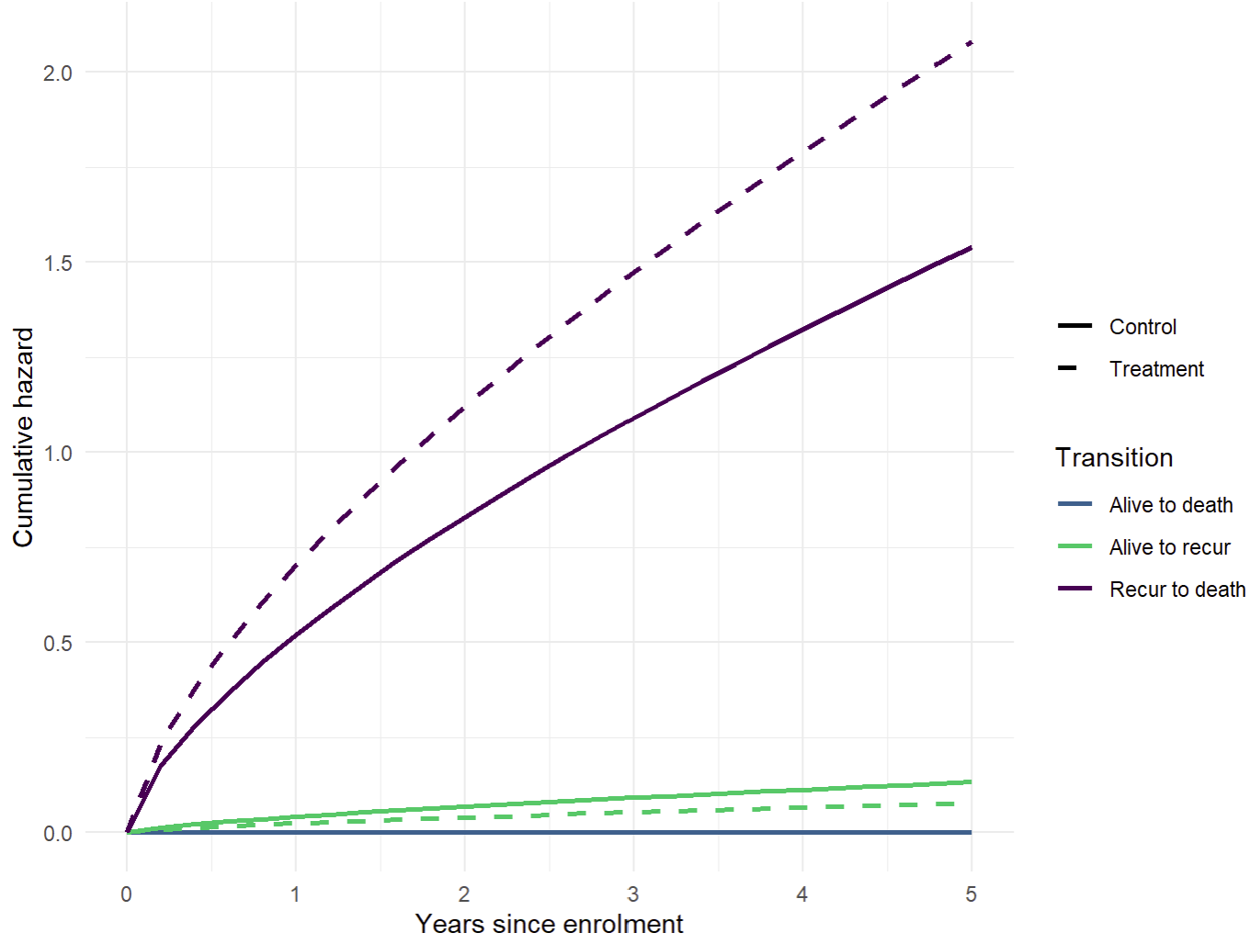
Cumulative hazard - Flexsurvspline

Slide 92
Probability in state
#Probability in state – control
prob_instate0 <- probtrans(cum_trans0, predt=0, direction="forward")
#Probability in state – treatment
prob_instate1 <- probtrans(cum_trans1, predt=0, direction="forward")

Slide 93
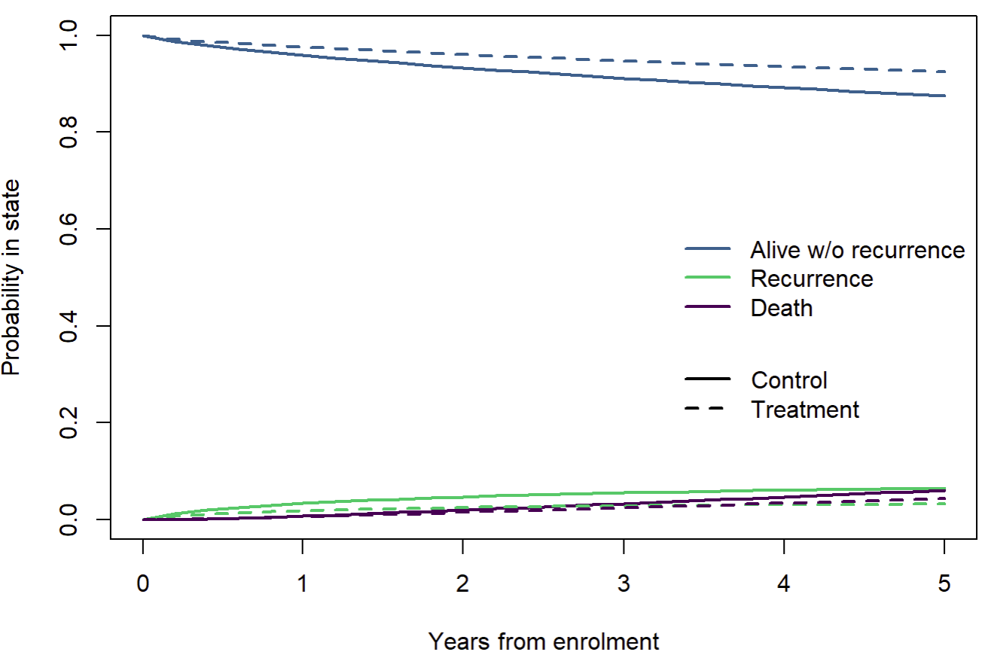
Probability in state

Slide 94
Important observations
Cumulative hazard and probability in state have differed to coxph()
Estimated covariate effects are similar → relative effects similar
Probability in state → absolute effects differ
Fundamental difference in baseline hazard functions

Slide 95
‘flexsurvreg’

Slide 96
Using ‘flexsurvreg’
Fits fully parametric survival model
Similar functionality to ‘flexsurvspline’
Coding provided & similar output

Slide 97
Transition-specific covariates

Slide 98
To fit strata(trans) or not to fit
Strata(trans) – fits as joint likelihood
Transition specific models – partition likelihood for separate model fit
Benefit – computationally easier for transition specific models
Notes:
Highlight important distinction between fitting trans as strata vs transition specific.

Slide 99
Recurrent events

Slide 100
Multi-state models for recurrent events
Can be fitted for recurrent events
Transition-specific for each recurrence
Time-varying covariate with recurrence number
Which to choose? Depends on scenario.
Few cases with multiple recurrence: Better fit with time-varying covariate
Covariate effects vary for each recurrence: Consider transition-specific or interaction terms with time-varying covariate
Directly interested in cumulative effect of recurrence.

Slide 101
Data setup
Can’t use mstate for circular/recurrent events
Data set-up becomes manual

Slide 102
Simulated data
Clinical trial over 24 weeks among people seeking treatment for opiod use disorder.
Sample of 260 participants in BUP-NX treatment and 187 participants in XR-NTX treatment.
Socio-demographics available.
Chrysanthopoulou SA, Wang J, Nolen S, et al. Modeling Recurrent Events: A Tutorial Based on Relapse and Remitting Episodes during Medication-Assisted Treatment for Opioid Use Disorder. Medical Decision Making. 2025;0(0). doi:10.1177/0272989X251395679

Slide 103
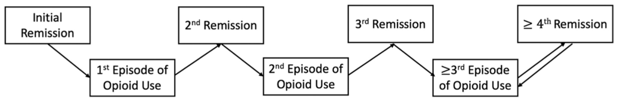
Simulated data

Slide 104
Simulated data
1
Entry
2
Relapse
3
Remission

Slide 105
Fitting transition-specific for each recurrence
#Fit separate models for each transition
op_relap_1 <- flexsurvspline(Surv(Tstart, Tstop, status) ~ trt + homeless, data=opiod_msm, subset=(trans==1), k=1, scale="hazard")
op_remiss_1 <- flexsurvspline(Surv(Tstart, Tstop, status) ~ trt + homeless, data=opiod_msm, subset=(trans==2), k=1, scale="hazard")
op_relap_2 <- flexsurvspline(Surv(Tstart, Tstop, status) ~ trt + homeless, data=opiod_msm, subset=(trans==3), k=1, scale="hazard")
op_remiss_2 <- flexsurvspline(Surv(Tstart, Tstop, status) ~ trt + homeless, data=opiod_msm, subset=(trans==4), k=1, scale="hazard")
op_relap_3 <- flexsurvspline(Surv(Tstart, Tstop, status) ~ trt + homeless, data=opiod_msm, subset=(trans==5), k=1, scale="hazard")
#Note by this transition, model is having difficulty fittingop_remiss_3 <- flexsurvspline(Surv(Tstart, Tstop, status) ~ trt + homeless , data=opiod_msm, subset=(trans==6), k=0, scale="hazard")op_remiss_3

Slide 106
Fitting transition-specific for each recurrence
Issues with cumulative hazard start arising…
Demonstrated in coding for completeness but the model isn’t coping with the number of new transitions, states and few events.

Slide 107
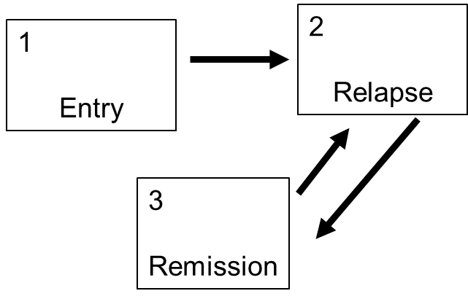
Fitting recurrence number as time-varying covariate
#Fit separate models for each transition
op_to_1recur <- flexsurvspline(Surv(Tstart, Tstop, status) ~ trt + homeless, data=opiod, subset=(trans==1), k=1, scale="hazard")
op_to_allremiss <- flexsurvspline(Surv(Tstart, Tstop, status) ~ trt + homeless + relapse, data=opiod, subset=(trans==2), k=1, scale="hazard")
op_to_allrecur <- flexsurvspline(Surv(Tstart, Tstop, status) ~ trt + homeless + relapse, data=opiod, subset=(trans==3), k=1, scale="hazard")op_to_allrecur

Slide 108
Fitting recurrence number as time-varying covariate
Because we have entry state, relapse number cannot be included in first transition (all values = 0).
Can look at recurrence effect on transitions, which cannot be done with prior model
Model copes much better with fewer states and fewer new transitions, with people being transient.
Cumulative hazards are produced and sensible.
msprep does not perform circular transitions, so this needs to be coded manually (in our example, it doesn’t matter).

Slide 109
Considerations

Slide 110
Model considerations
Clinically relevant model vs availability of data to reflect these.
Too few data for transitions may cause convergence issues.
Measure of time: Origin or study entry, or age or calendar year.
Notes:
One must consider what is meant by time. In many causes, study origin or study entry may be appropriate measure of time zero. However, in observational studies, this may not be as it may not reflect anything important in terms of the disease progression etc. Alternate time may be age or calendar year. Consider how this will shift at risk population and subsequent model estimates as it would any other survival model.

Slide 111
Model considerations
Model not converging or model issues (e.g. negative probability in state)?
Consider:
Alternate model: less common to occur with Cox model
Reduce number of covariates
Reduce number of states / new transitions
For flexible parametric, reduce splines or change parametric distribution

Slide 112
Further concepts

Slide 113
Markov models
Markov property states that the future depends on the history only through the present.

Slide 114
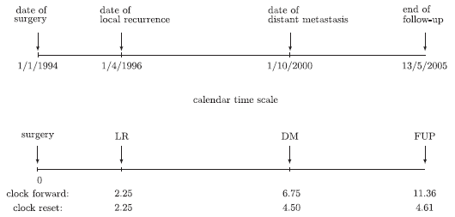
Model considerations
Inhomogeneous Markov (clock forward) vs semi-Markov (clock reset)
Notes:
Clock forward counts from timepoint 0 consecutively for each event.
Clock reset, starts recounting from the last event.
Underlying assumption here is that once they transition to the next state, their ‘at risk’ resets to 0.
For clock reset – transition intensity depends on time t since entry into current state
For clock forward – transition intensity does not depend anymore on prior states, besides time
Homogeneous Markov chain – transition intensity remains constant over time

Slide 115
Markov models
msm package –
Markov models
Hidden Markov model – states of Markov chain not observed
Exact times ‘not observed’
Transition probability matrices
Mean sojourn times
Probability each state is next
Total length of stay
Expected first passage times
Expected number of visits
Hazard ratios for transition
Notes:
More computationally challenging

Slide 116
Data exercise

Slide 117
“Real” data
822 dialysis patients who have entered the kidney waitlist for a transplant.
Temporary suspension can occur on the waitlist.
Transitions considered up to transplant from active state.
Reality: deaths occurring any time and transplant can occur during suspension

Slide 118
“Real” data
1
Active
3
Transplant
2
Suspended

Slide 119
Questions?

